Slide 1
SOEN 6611-SOFTWARE MEASUREMENT
Team M
Submitted by:
Harsh Mehta 40098439
Yash Golwala 40085663
Navroop Virk 40043821
Raghav Dutta 40067534
Manisha Jalota 40079362
Submitted To:
Jinqui Yang

Slide 2
GOAL ?
Setting up environment for projects.
Metric 1-Statement Coverage.
Metric 2-Branch Coverage.
Metric 3-Mutation Score.
Metrics 4 -McCabe Cyclomatic Complexity
Metrics 5- Adaptive Maintenance Effort Model
Metrics 6- Software Defect Density (DD)
Correlations:
1. Metric 1 and 2
2. Metric 1 and 3
3. Metric 1 and 4
4.Metric 2 and 3
5. Metric 2 and 4
6. Metric 3 and 4
7. Metric 5 and 6

Slide 3
PROJECTS:
S.No. | Name | Lines of Code | Version | Details:
1. | Apache Commons Pool | 14.3K | 2.6.2 | The Apache Common Pool open source software library provides an object-oriented pooling API.
2. | Apache Commons Math | 174K | 3.5.1 | The Apache Commons Math project is a library of lightweight, self-contained mathematics and statistics components addressing the most common practical problems not immediately available in the Java programming language or commons-lang.
3. | Apache Commons File Upload | 100K | 1.4 | The Apache Commons File Upload provides a simple yet flexible means of support for multipart file upload functionality .
4. | Apache Commons IO | 58.4K | 2.6 | The Apache Commons IO library contains utility classes, stream implementations, file filters, file comparators, endian transformation classes, and much more.
5. | Apache Commons Collections4 | 270k | 4.4 | The Java collection was a major addition in JDK 1.2. It added many powerful data structures that accelerate development of most significant Java applications.

Slide 4
SETTING UP THE ENVIRONMENT PROJECT
Installed tools such as Understand,CLOC,Maven etc.
Importing the project in IDE(eclipse).
Solved all the dependency errors.
Ran all the projects in tools and determined the branch coverage,statement coverage and cyclomatic complexity along with other metrics.
Computed the mutation score on Maven.

Slide 5
METRIC 1,2 AND 4: STATEMENT COVERAGE, BRANCH COVERAGE, CYCLOMATIC COMPLEXITY
Tool name: JaCoCo
Reasons behind choosing JaCoCo:
1. Free and Open-Source code coverage library for Java
2. Branch coverage, statement coverage and cyclomatic complexity, all can be done by
using this tool.
3. Integration with Various Tools (Eclipse, Maven plug-in, Gradle).

Slide 6
CHALLENGES
It was not as challenging as the other metrics, but still there were some difficulties while doing work on it.
Dependency errors
Versioning of projects

Slide 7
M3-MUTATION TESTING
How?-using PiTest
Tests are run on the code in which faults are seeded and test cases are run on this code automatically.Failing of test cases represents the killing of mutation while if test cases pass then the mutation is lived.
Why PiTest?
Fast - It takes only minutes to analyze the code instead of hours.
Easy to use and can be integrated with various softwares- works with ant, maven, gradle and others
Actively developed
Actively supported

Slide 8
CHALLENGES
Build failures with certain projects.
Multiple timeouts.
Problems finding the recognized sources for it.

Slide 9
IMPLEMENTING PITEST
Adding dependency in pom.xml
Adding target classes and test cases.
Adding timeout.
Adding number of threads
Adding threshold
Specified the formats for generation of report.
Run it using command in terminal with dWithHistory.
Results analyzed.

Slide 10
S. No. | Projects | Mutation Testing Results
1. | Apache Commons Pool | 80%
2. | Apache Commons Math | 85%
3. | Apache Commons FileUpload | 66%
4. | Apache Commons IO | 80%
5. | Apache Commons Collections4 | 42%

Slide 11
METRIC 5: ADAPTIVE MAINTENANCE EFFORT MODEL
Among several measures empirically considered and found that the number of revised LOC is strongly correlated to maintenance effort measured in units of time.
DLOC i.e change in the code in terms of addition and modification is calculated.
It is observed that change in number of LOC and number of operator changed are strongly correlated to maintenance effort.
Regression result in maintenance effort(E), E = 78 + 0.01DLOC, where E is effort in person hours where DLOC is number of lines of code changed.

Slide 12
APPROACH
Tool used:-CLOC
Determined the change in LOC for various versions of project along with the calculation of efforts put.
E = 78 + 0.01 * DLOC where E is maintenance effort in person hours

Slide 13
CLOC
Reason behind choosing the CLOC
Free source
Branches, lines, methods, and cyclomatic complexity coverage analysis.
Results from various runs are summed up.
Results can be produced in different formats.

Slide 14
METRIC 6: Defect Density
Defect Density is the number of defects confirmed in software/module during a specific period of operation or development divided by the size of the software/module.
Defect Density = Defect count/size of the release
Algorithm :
Step 1: Calculate the number of defects arising in different modules(release/built/cycle). Step 2: Calculate the size of the software that can be measured in KLOC.

Slide 15
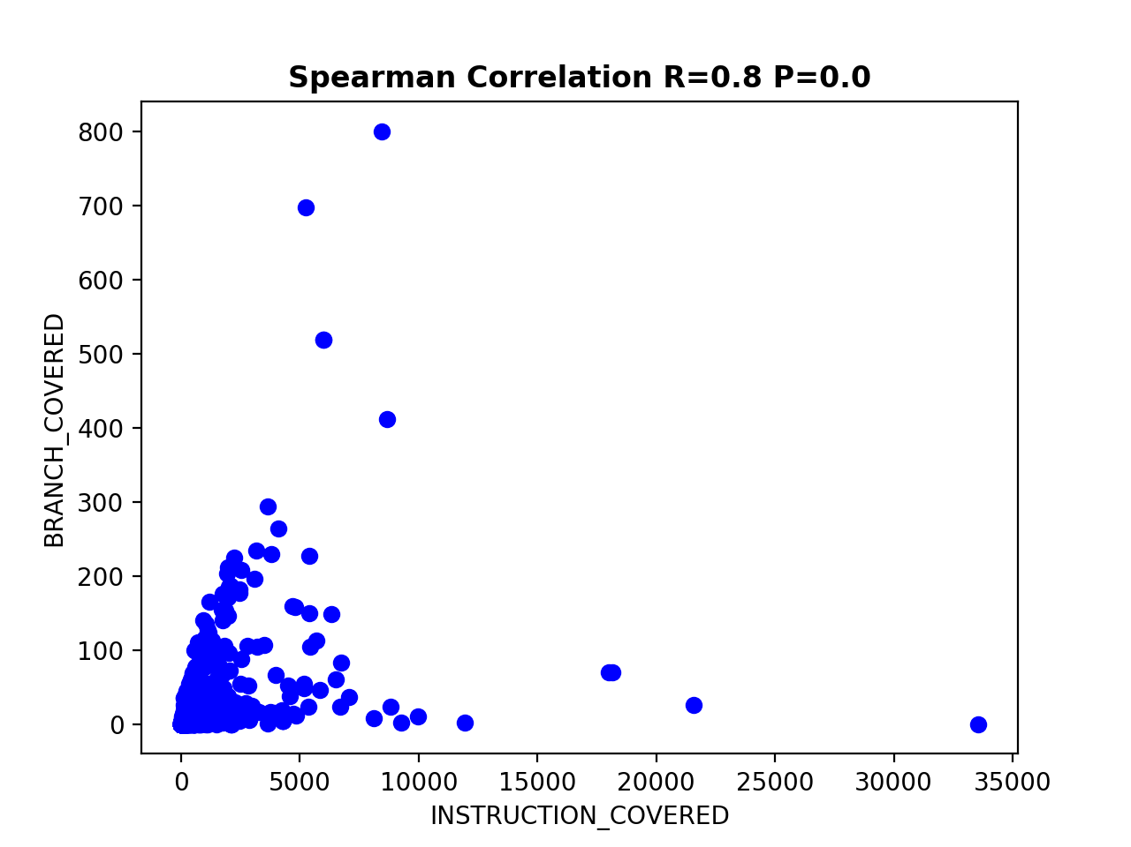
Correlation Between Metrics
Metric 1 and 2

Slide 16
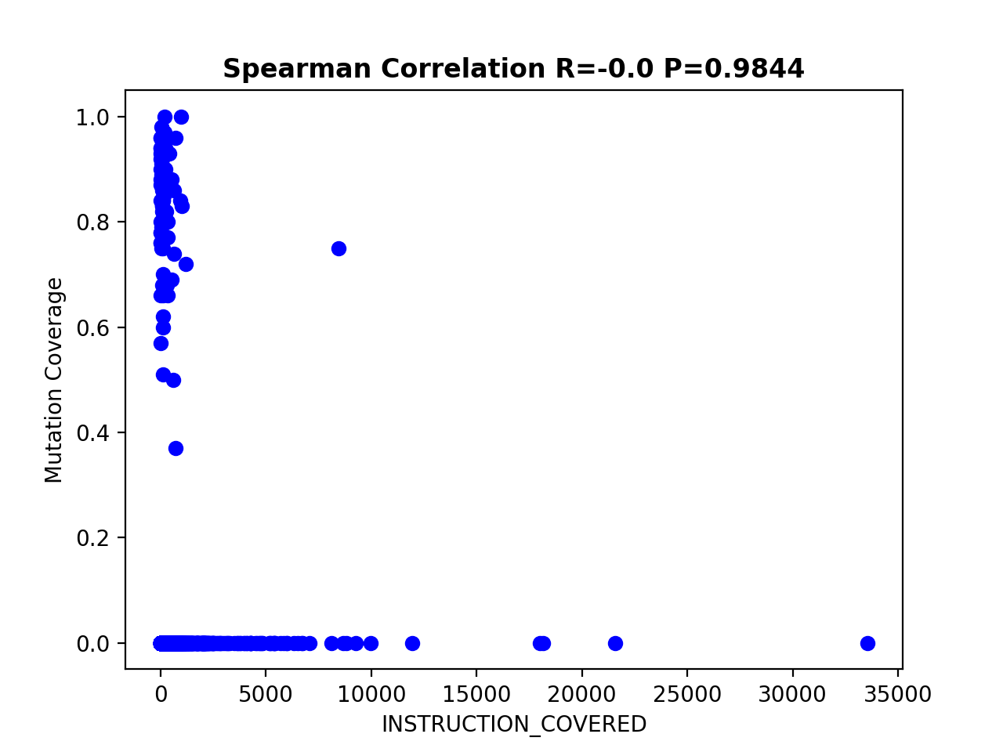
Metric 1 and 3 Apache Commons Math

Slide 17
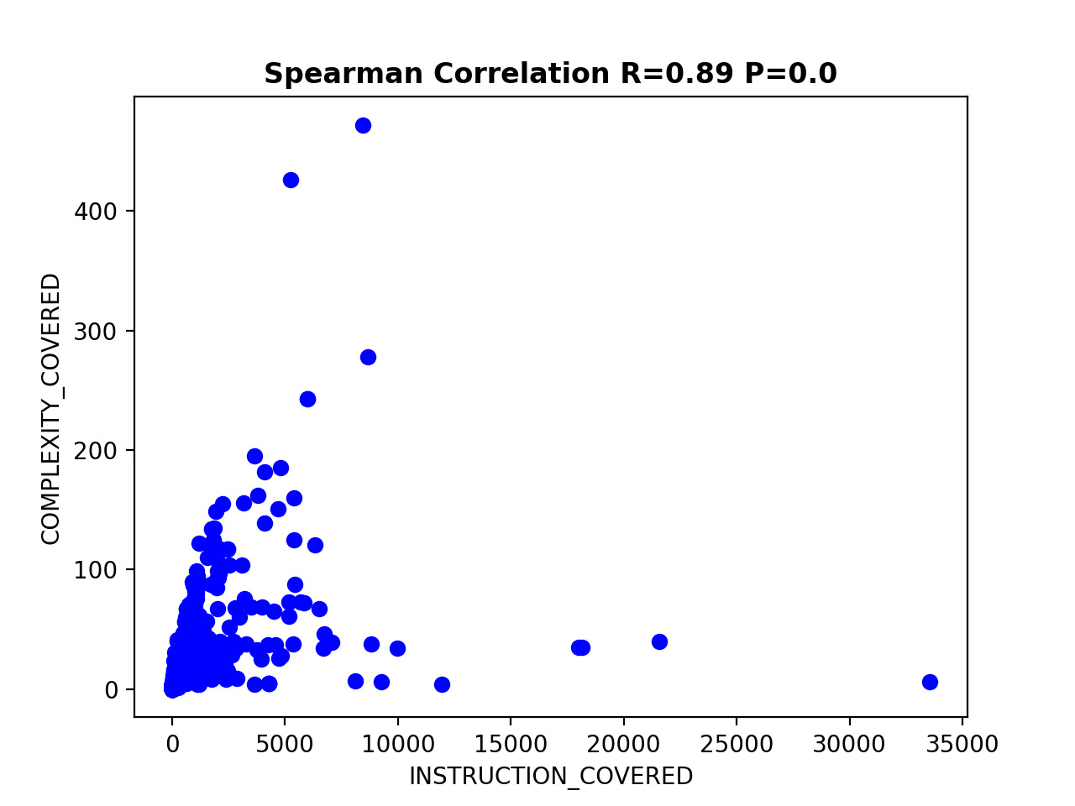
Metric 1 and 4 Apache Commons Math

Slide 18
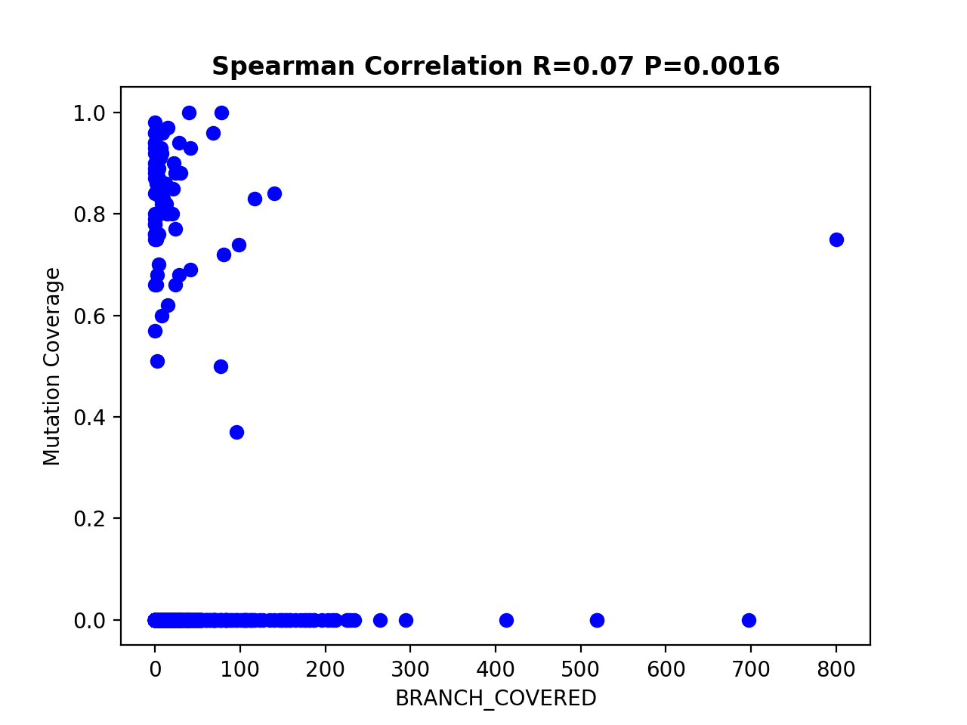
Metric 2 and 3 Apache Commons Math

Slide 19
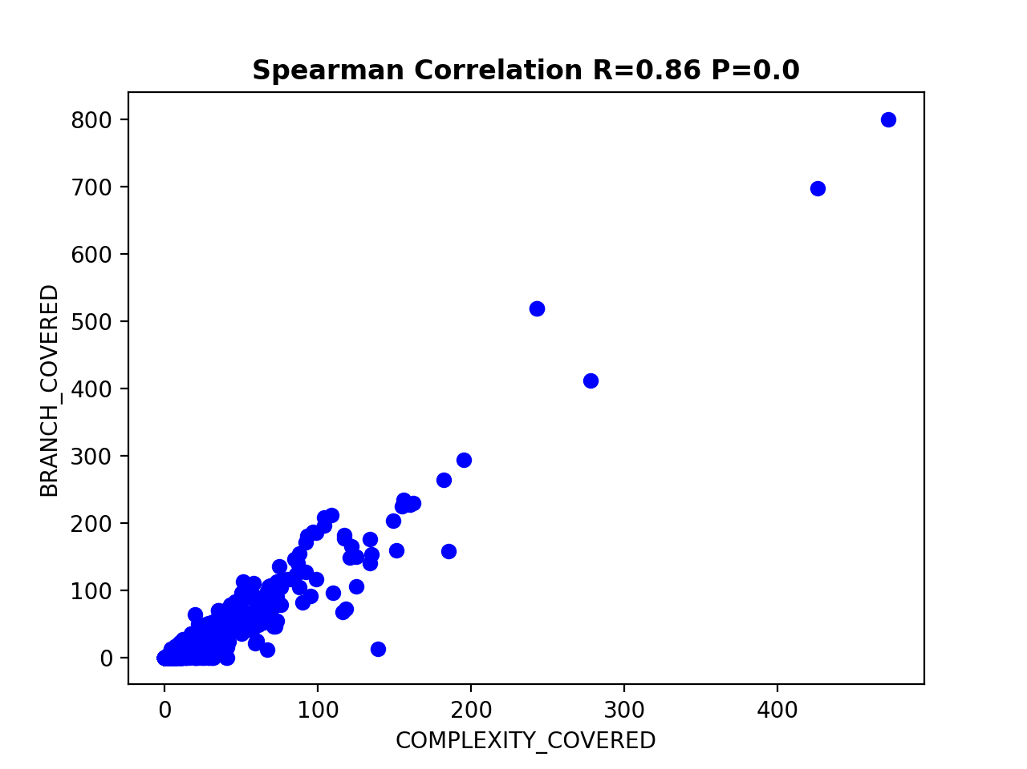
Metric 2 and 4 Apache Commons Math

Slide 20
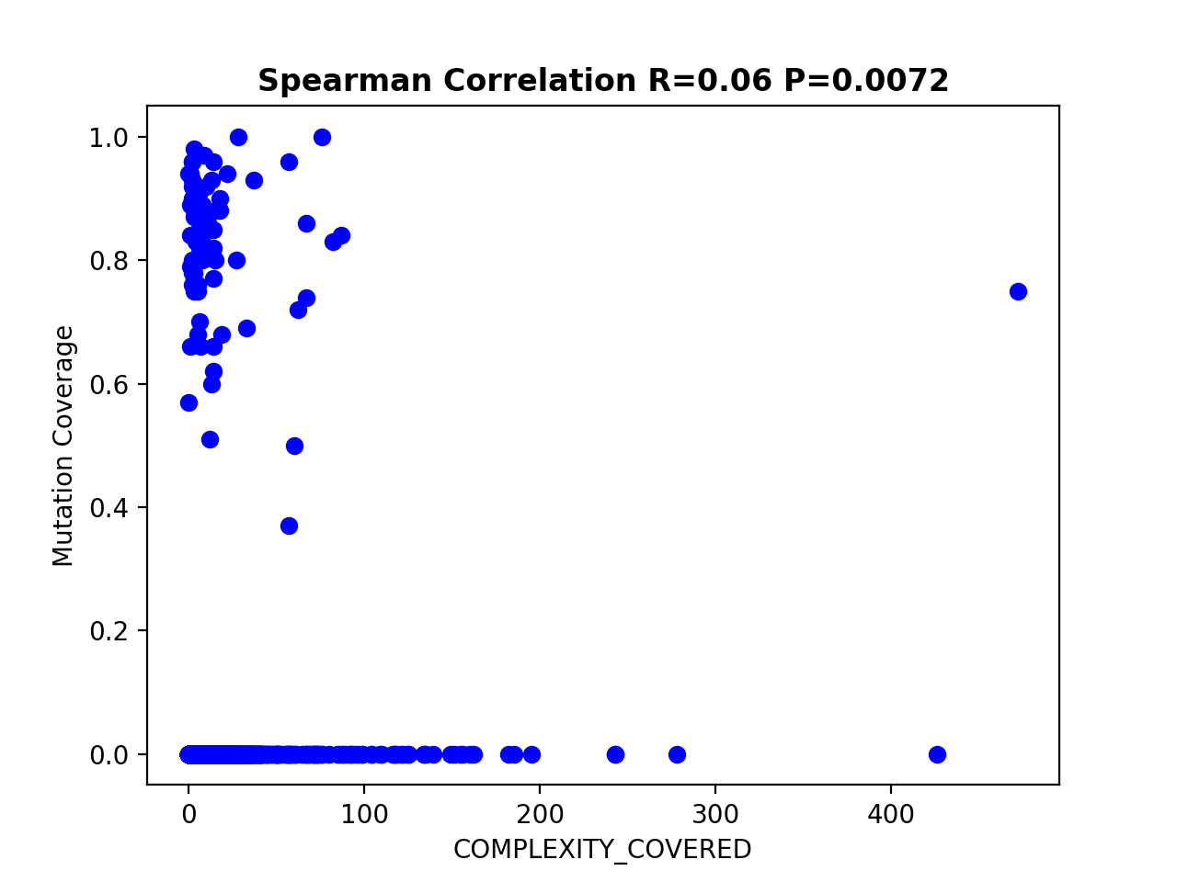
Metric 3 and 4 Apache Commons Math

Slide 21
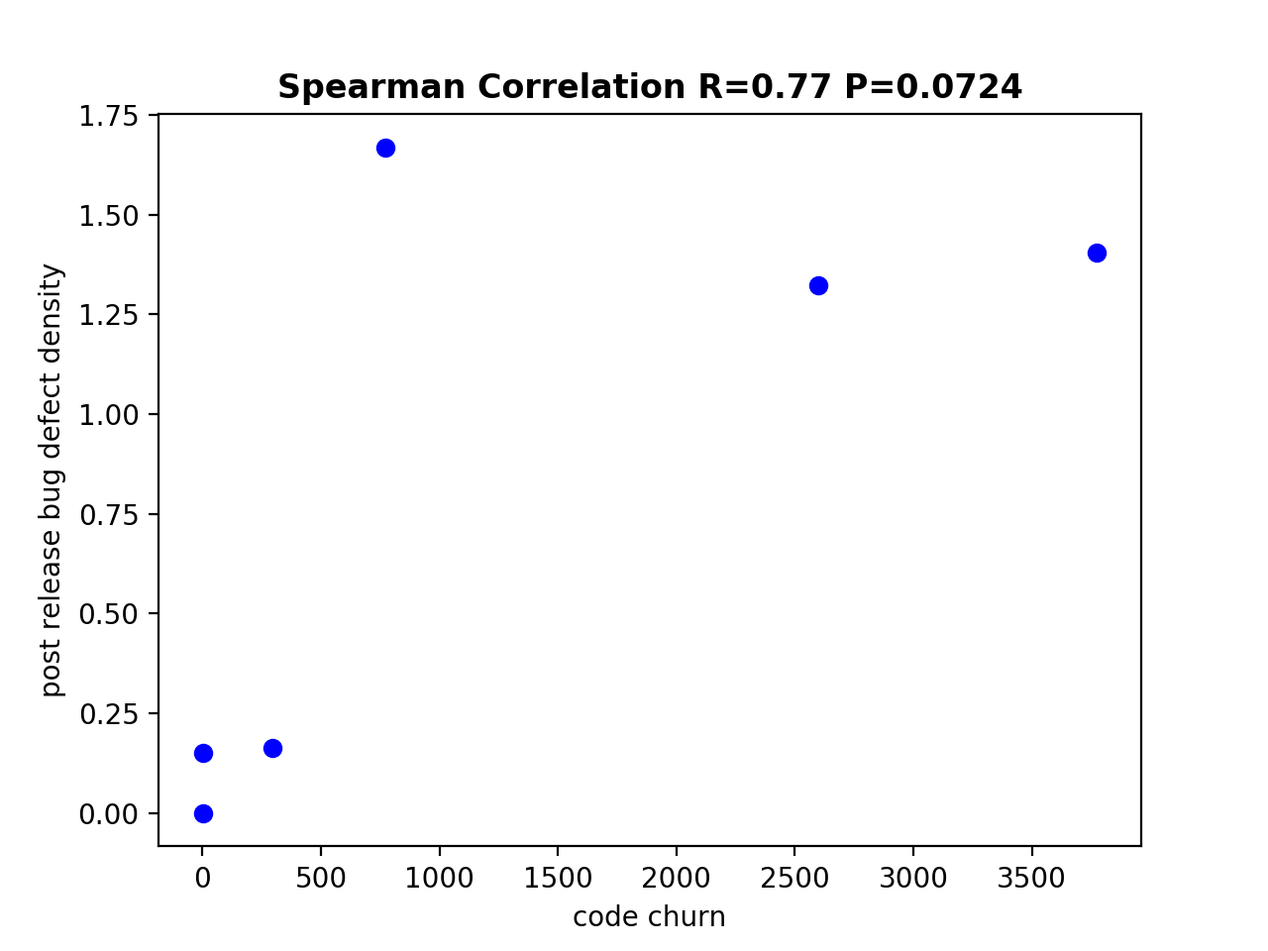
Metric 5 and 6 - Apache Commons File Upload

